Slide 1
Upgrading the IMWX boxcar kit
Making a great kit even better

Slide 2
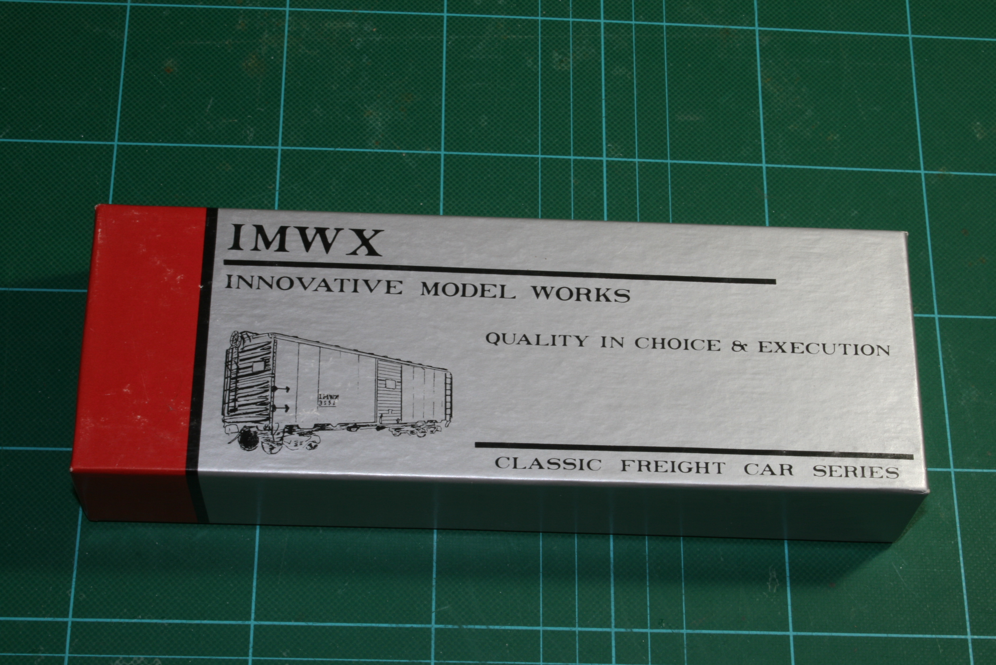

Slide 3
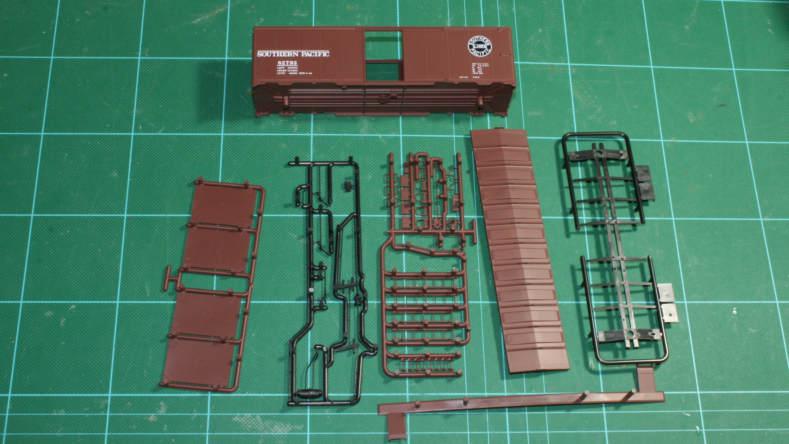

Slide 4
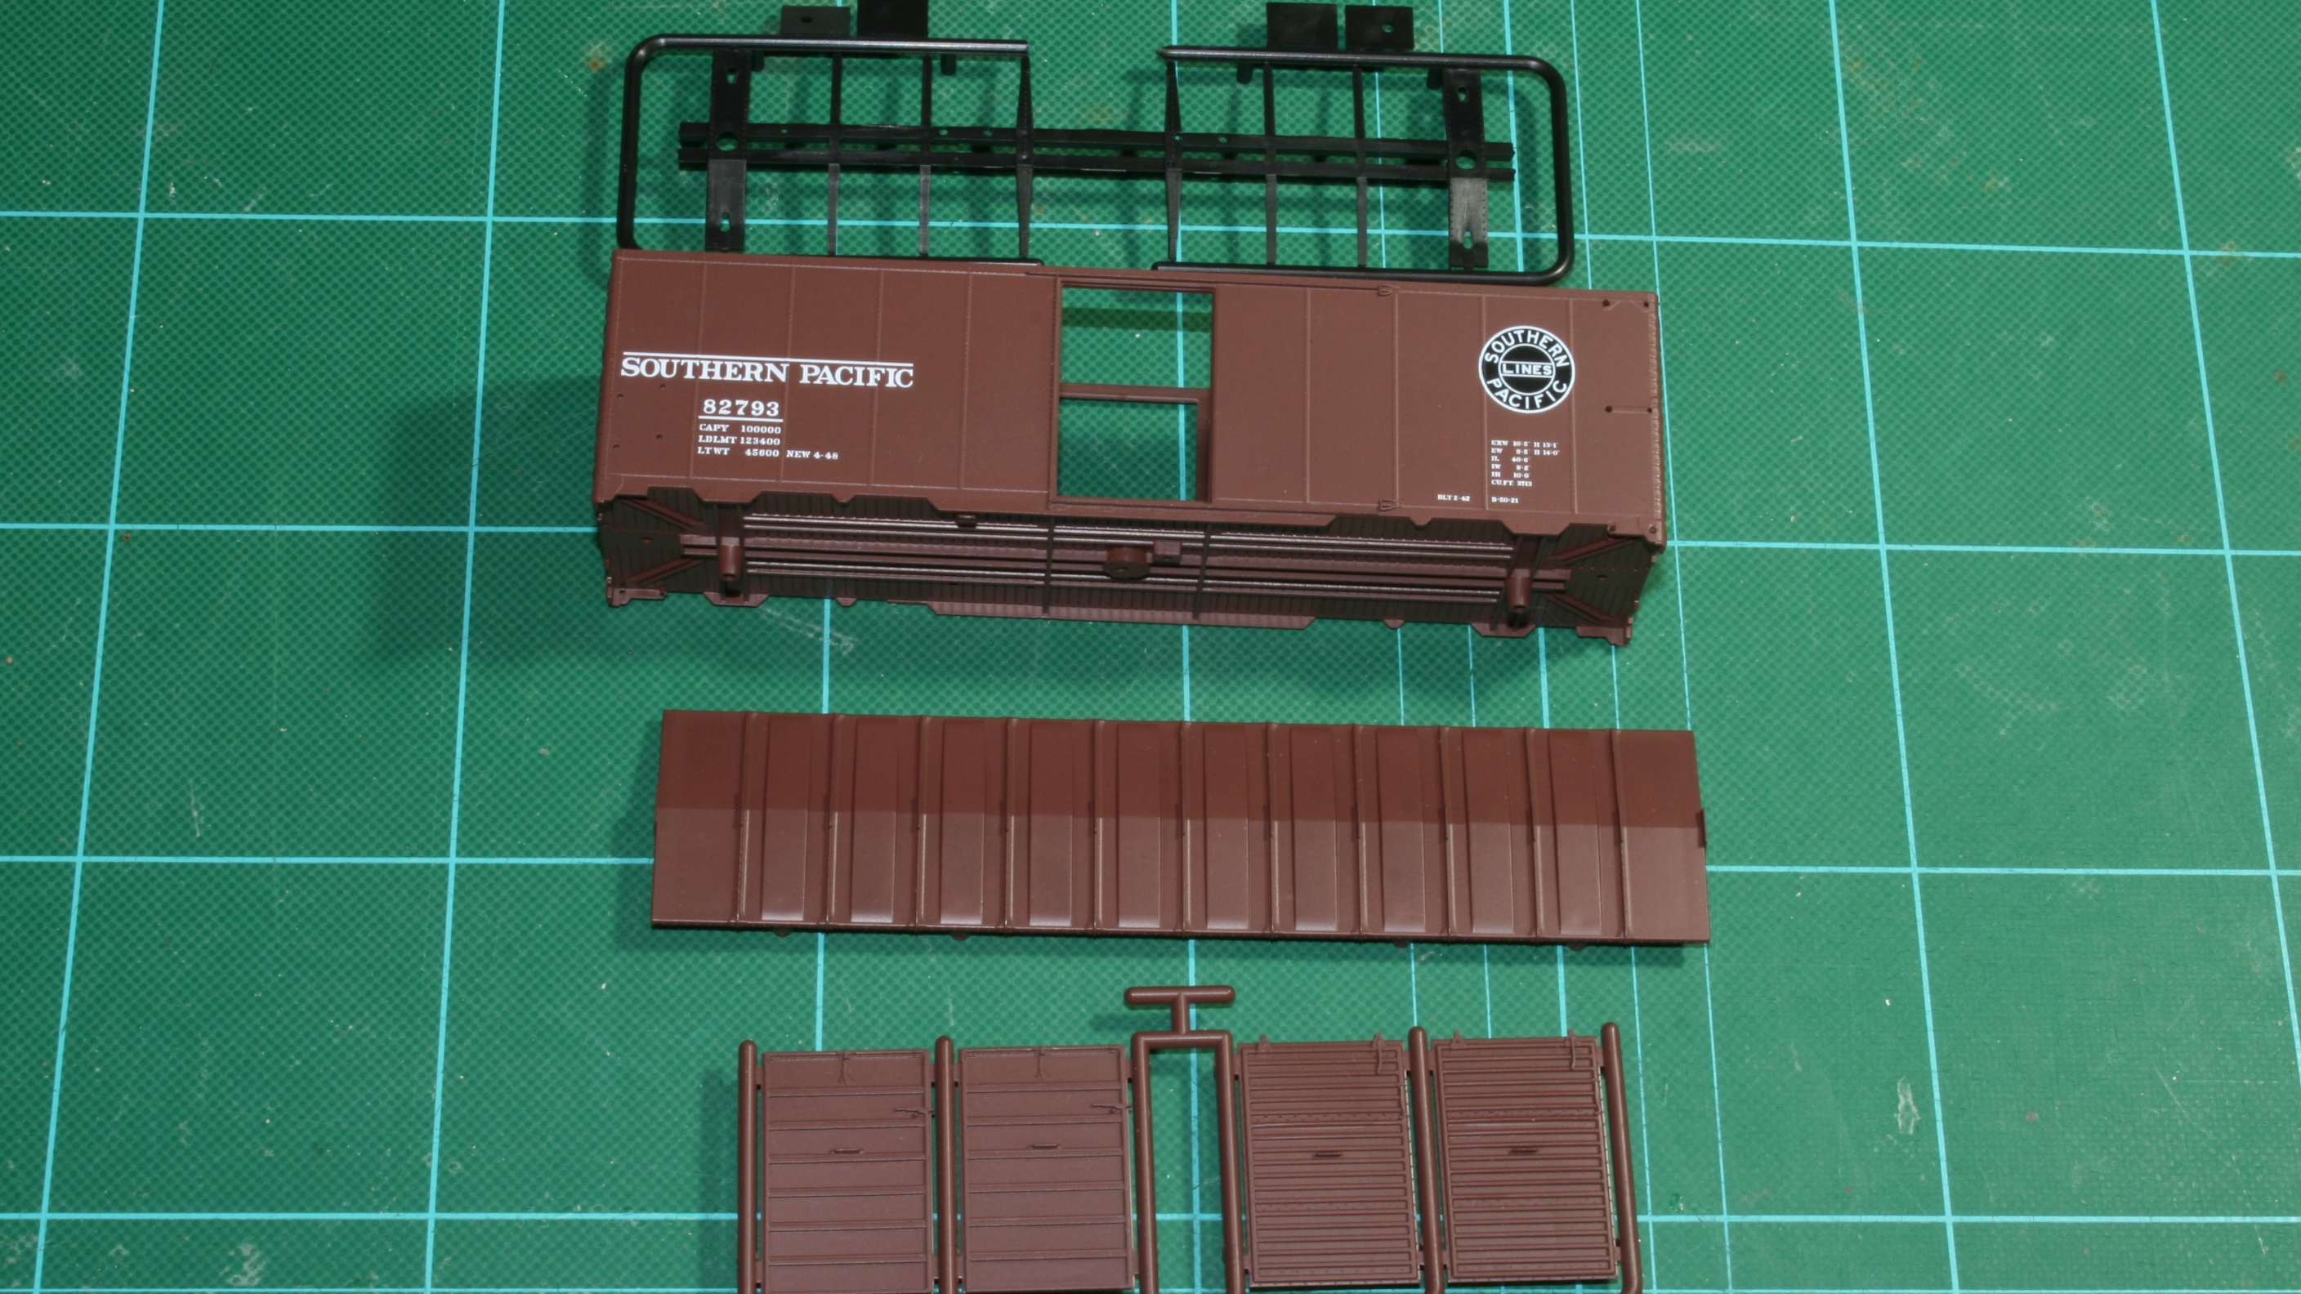

Slide 5
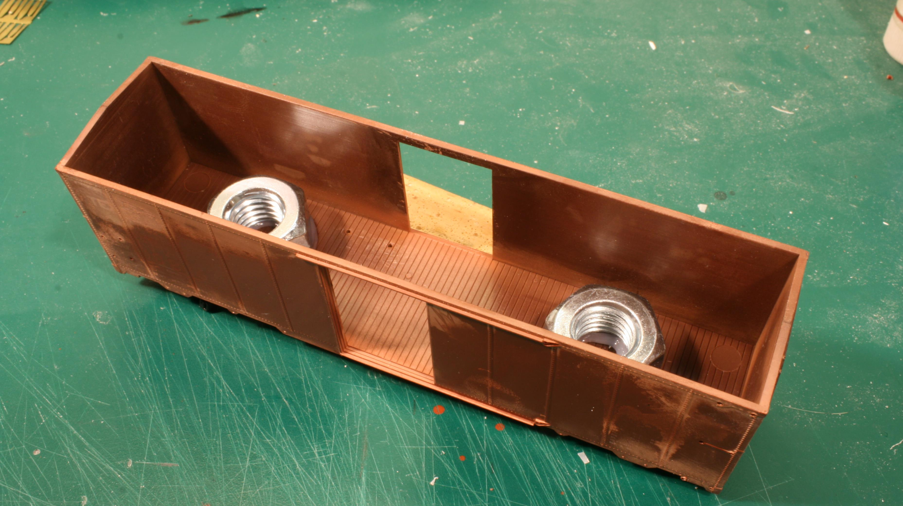

Slide 6
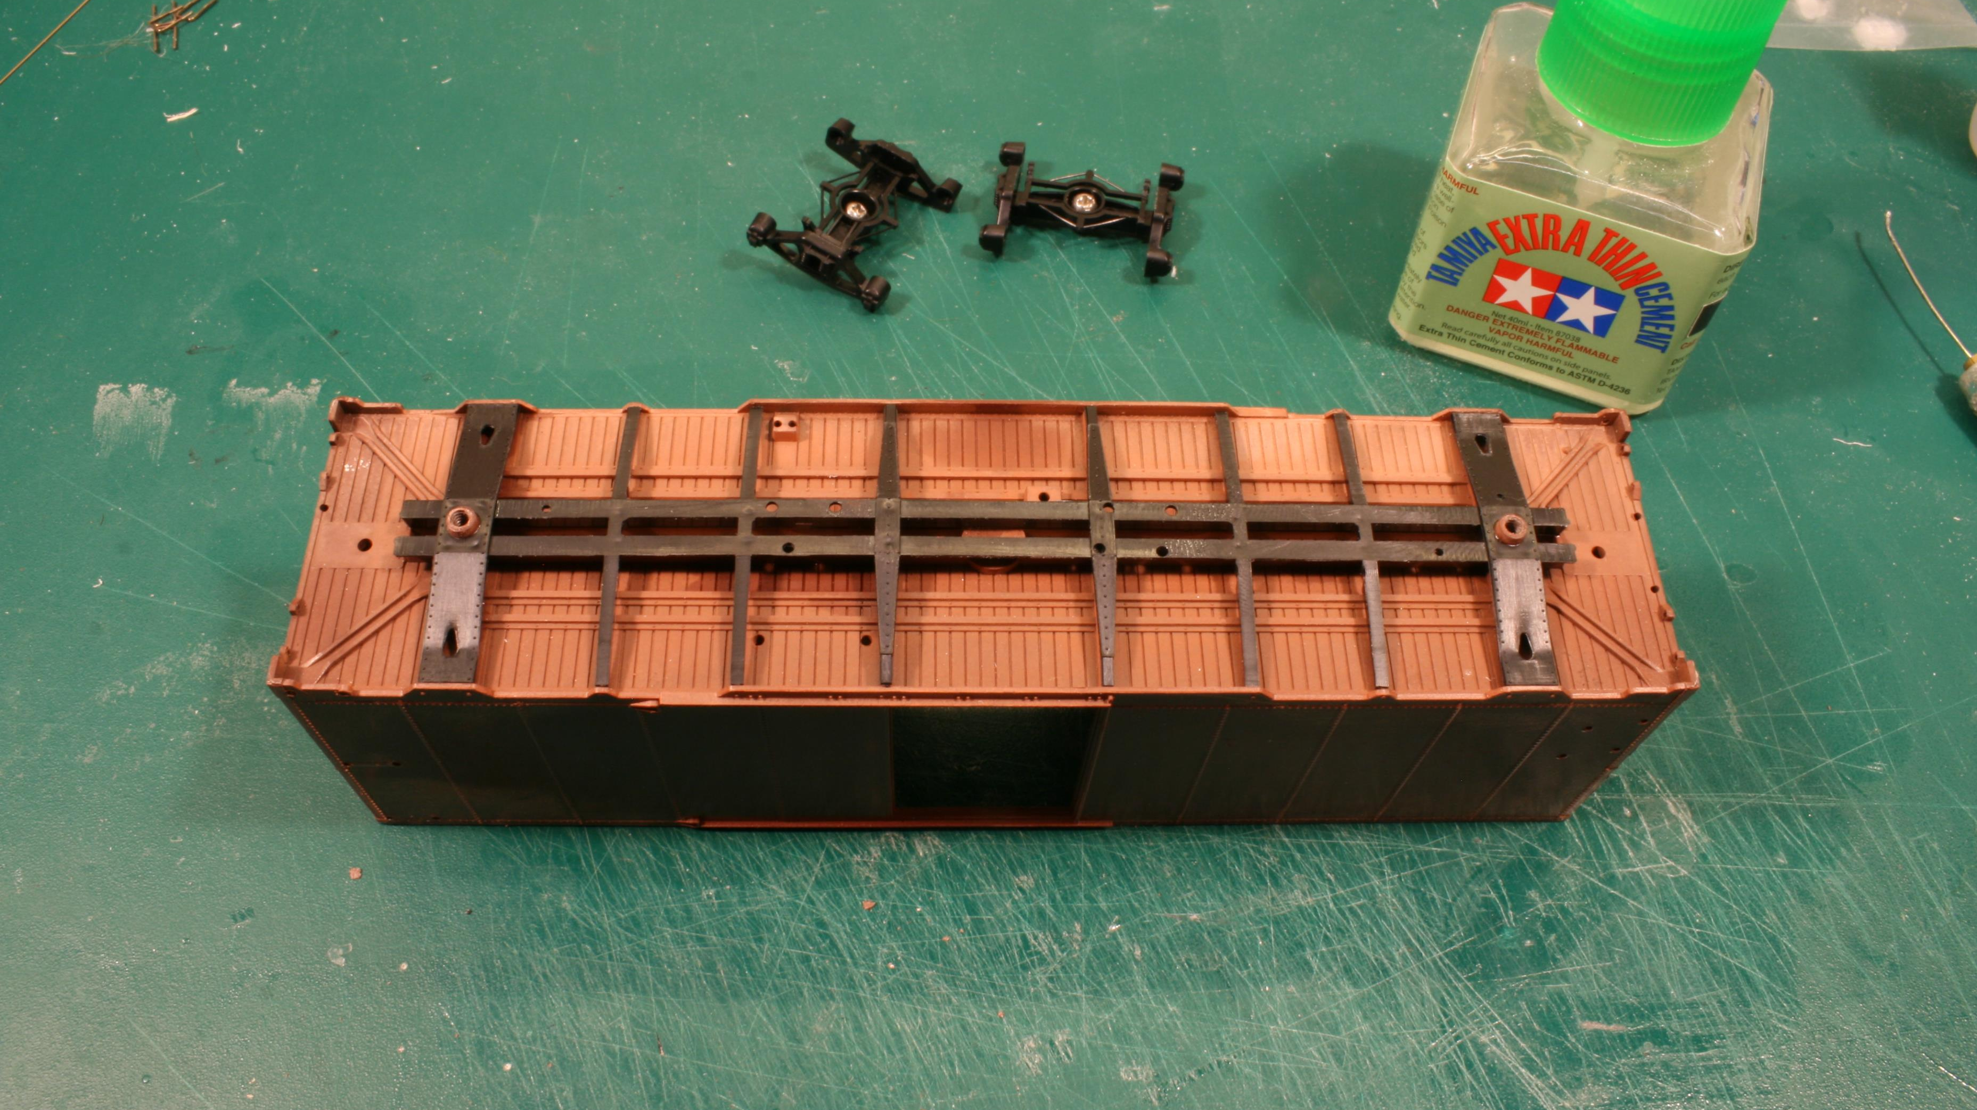

Slide 7
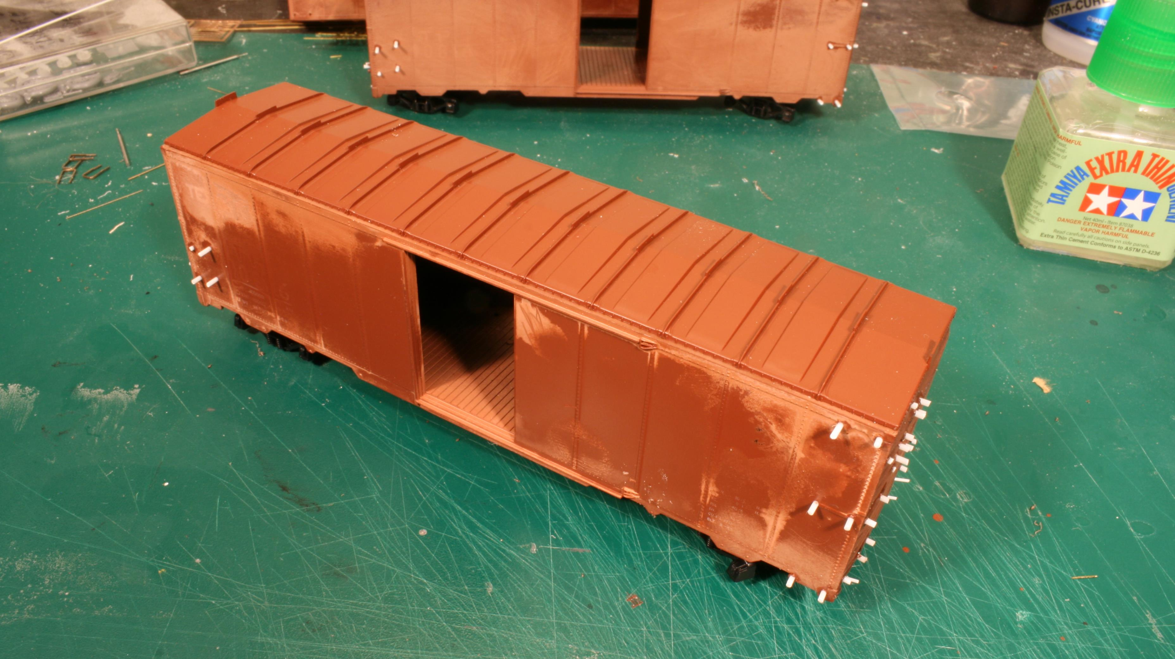

Slide 8
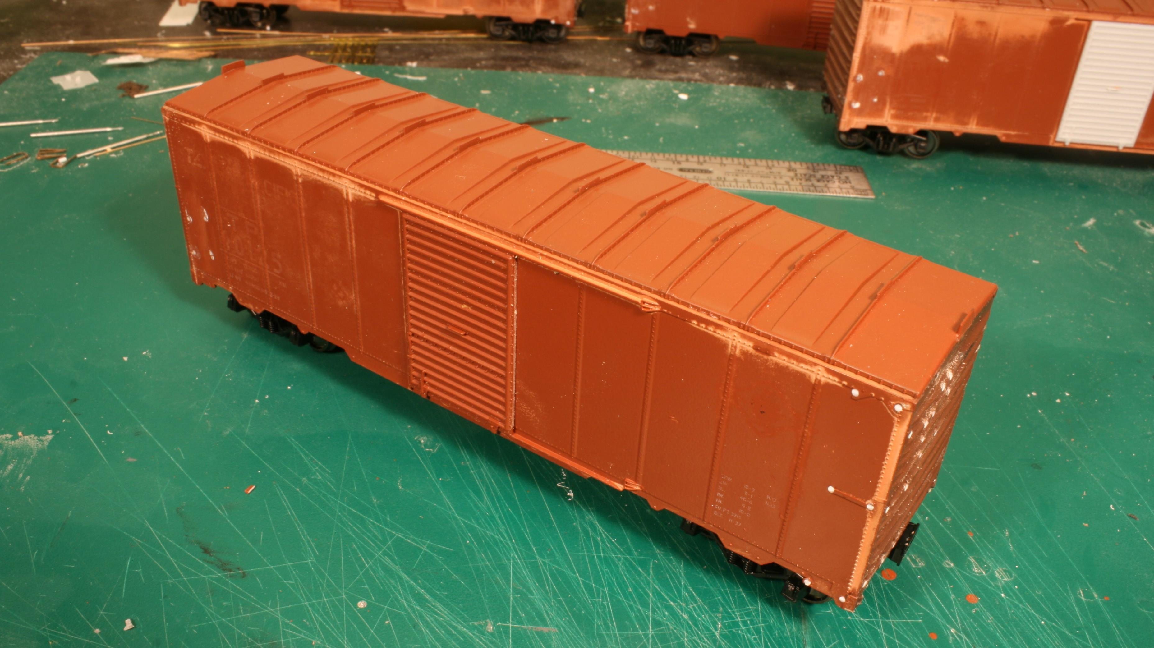

Slide 9
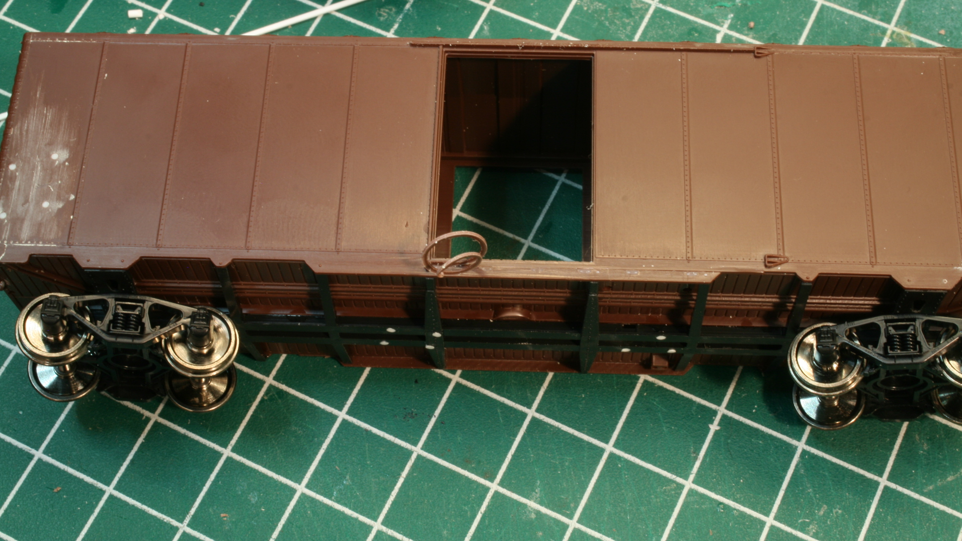

Slide 10
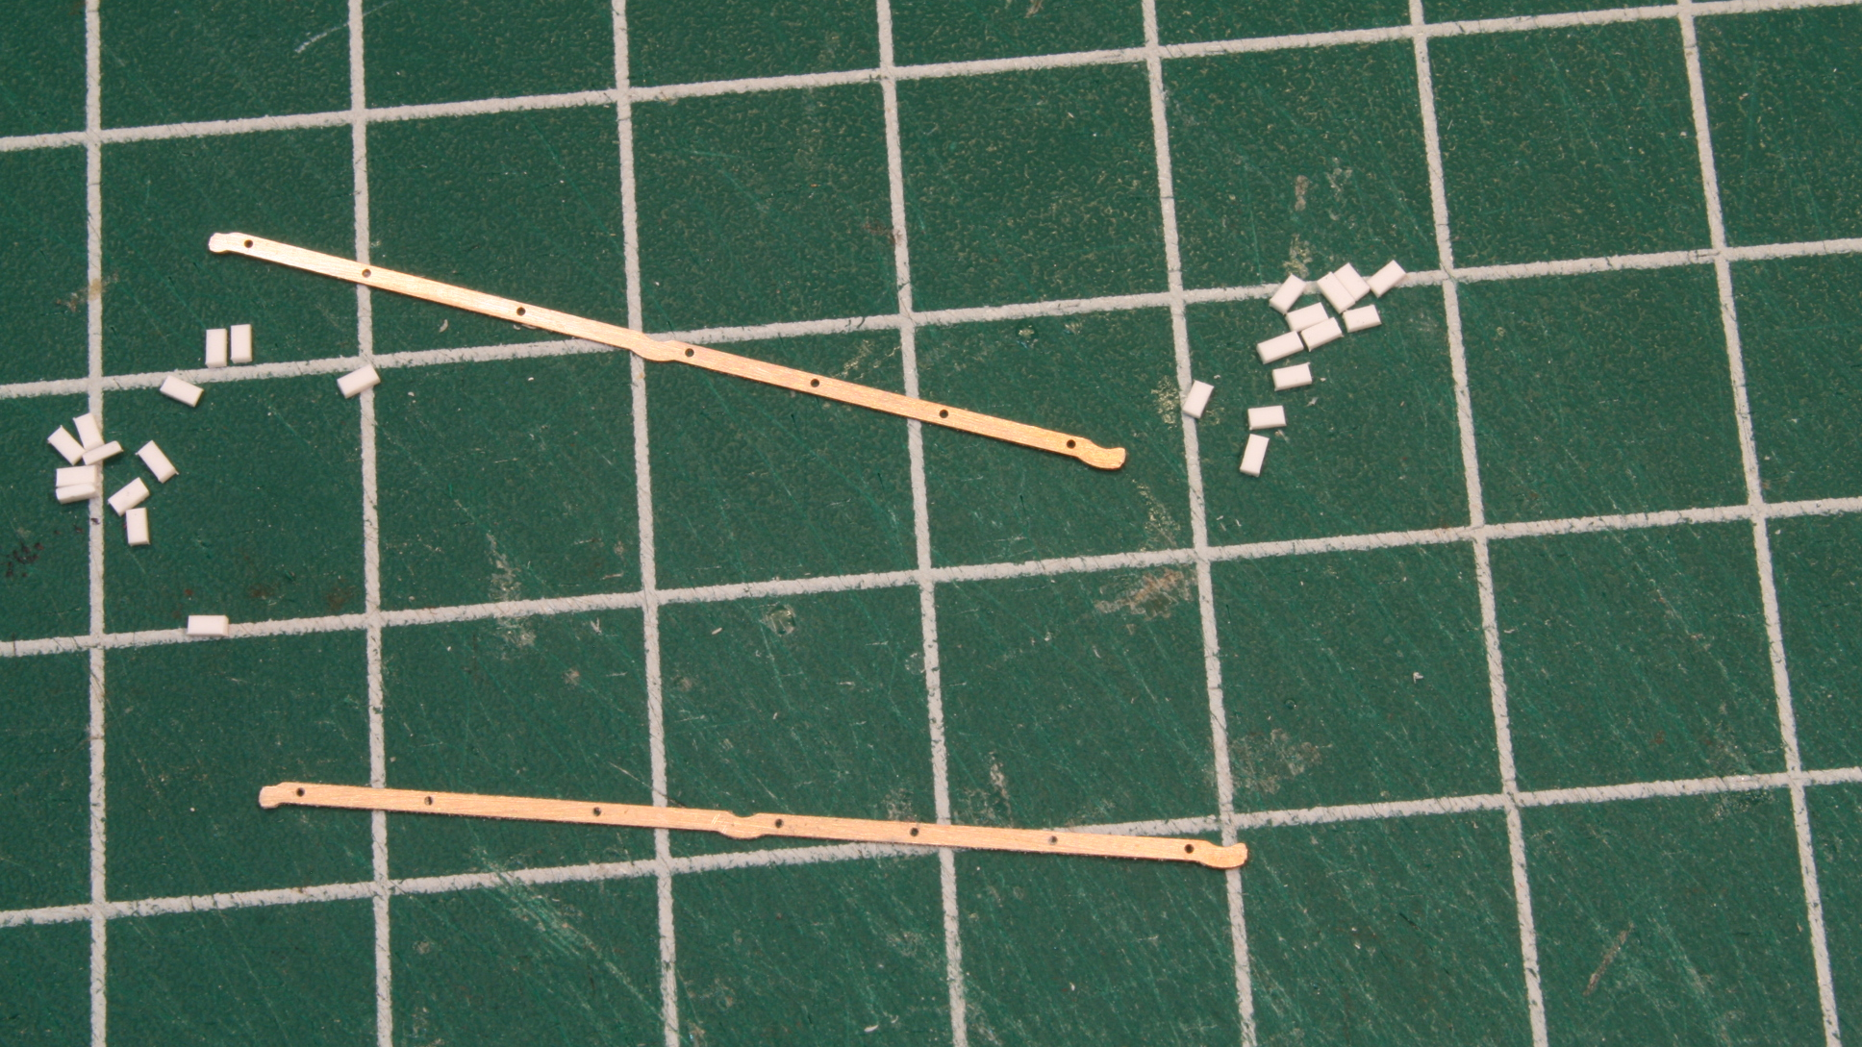

Slide 11
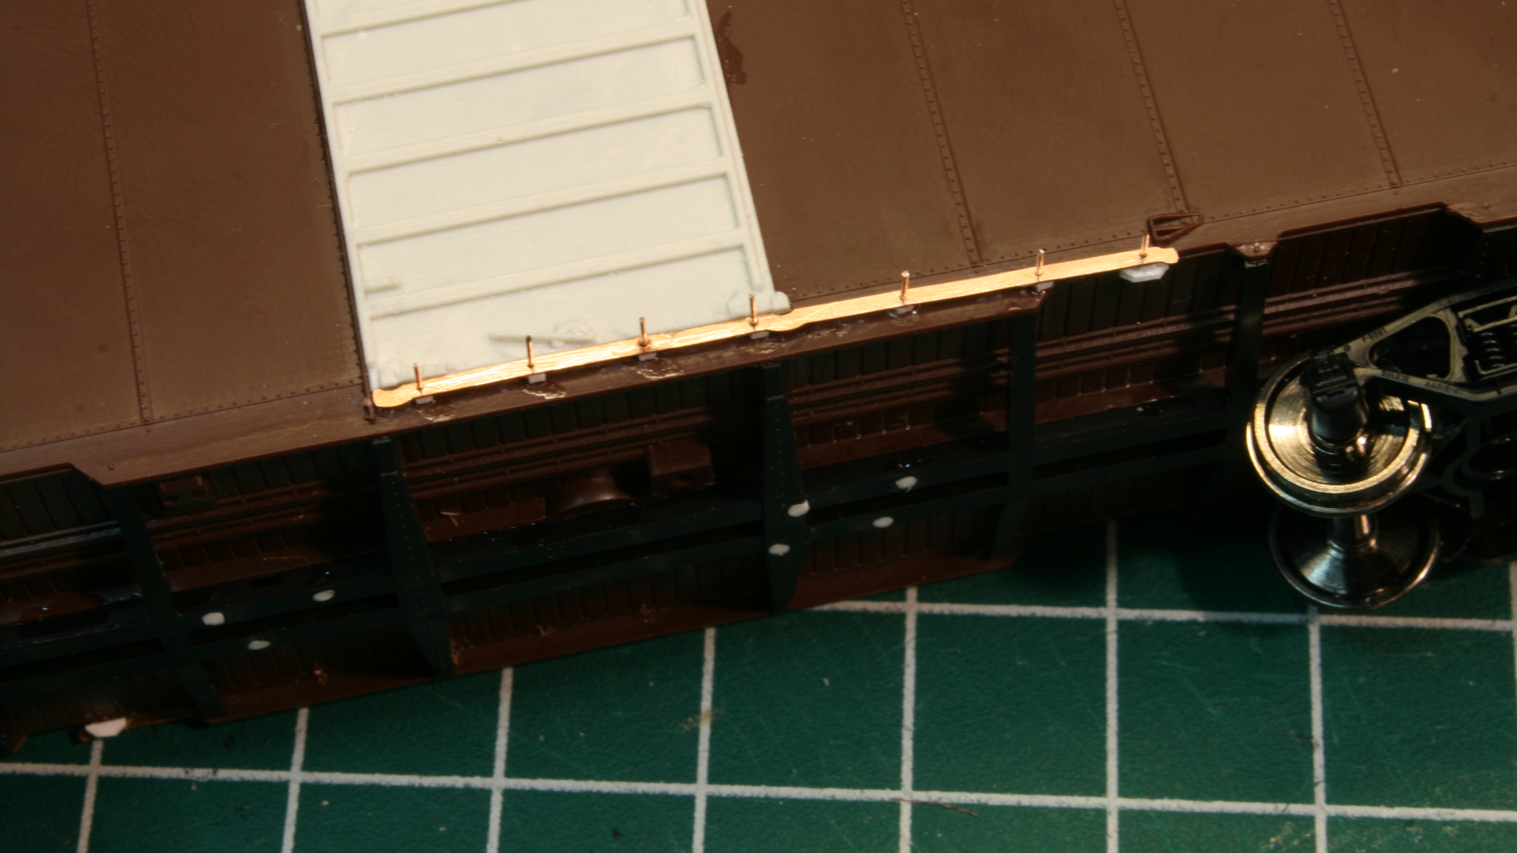

Slide 12
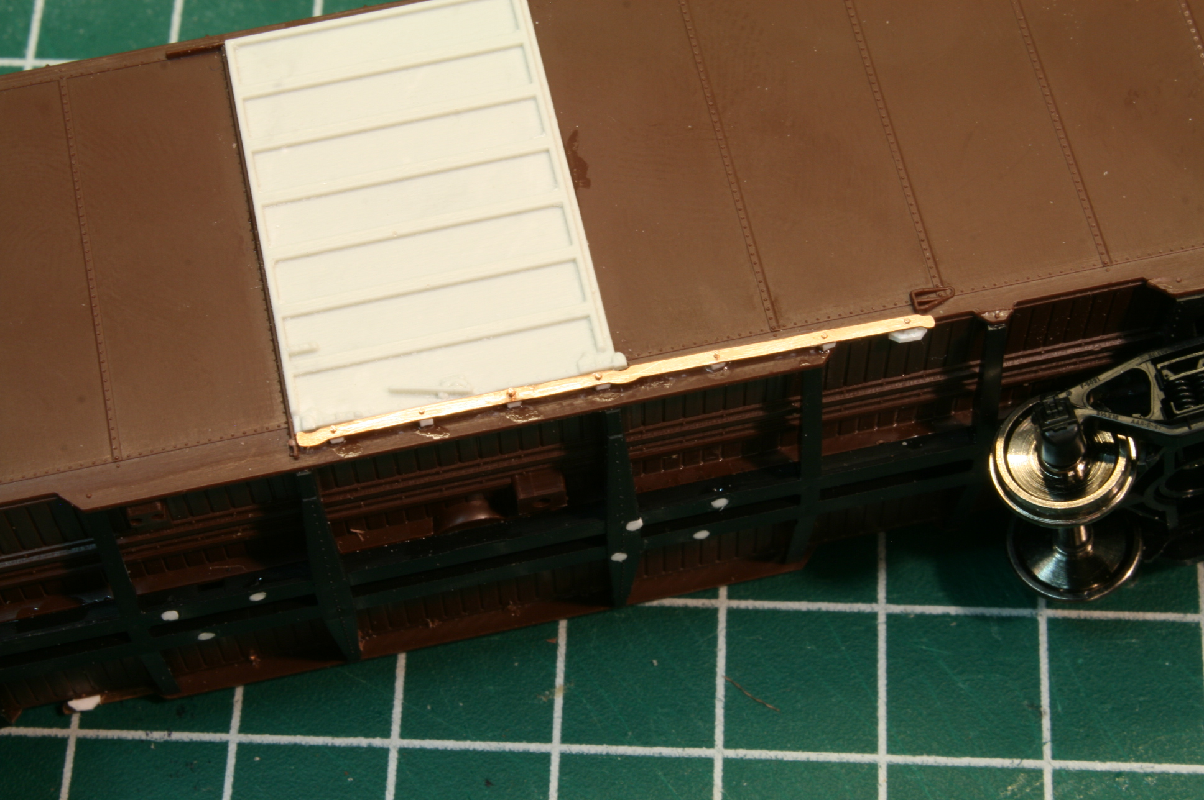

Slide 13
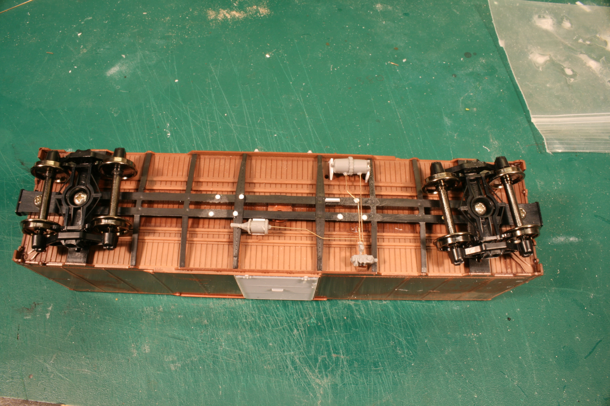
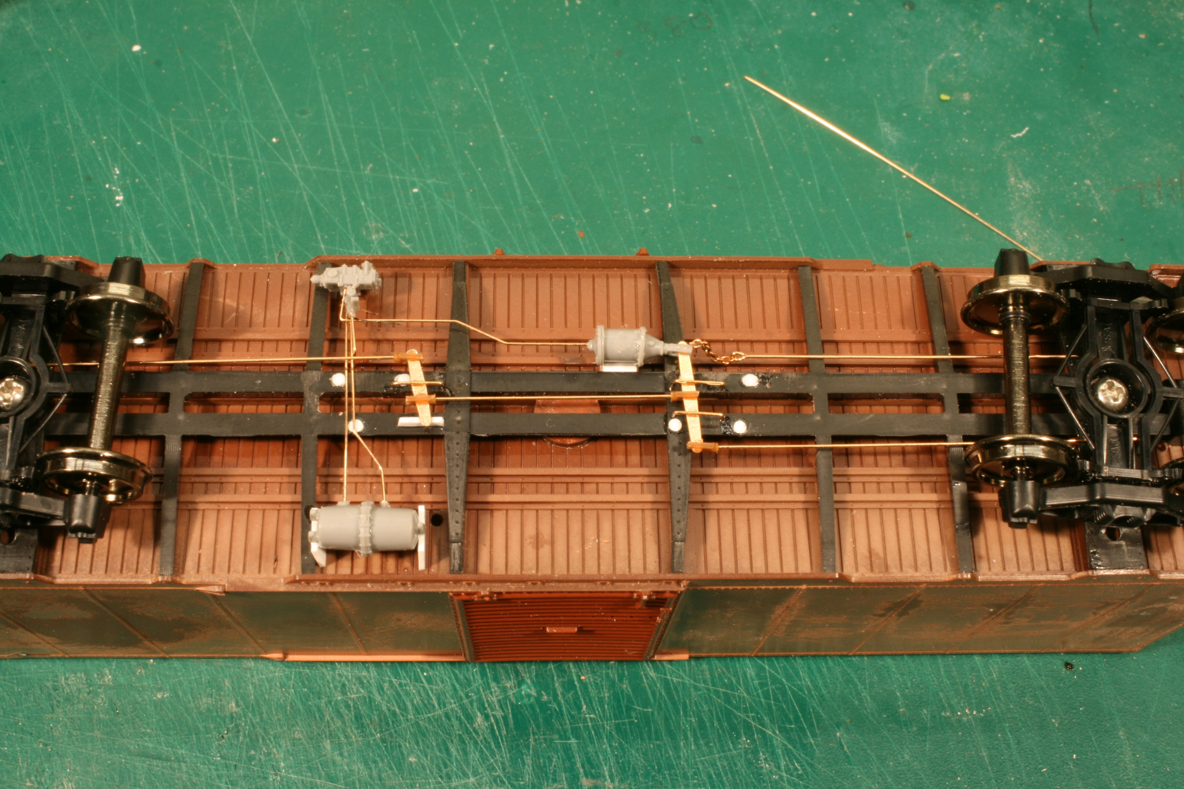

Slide 15
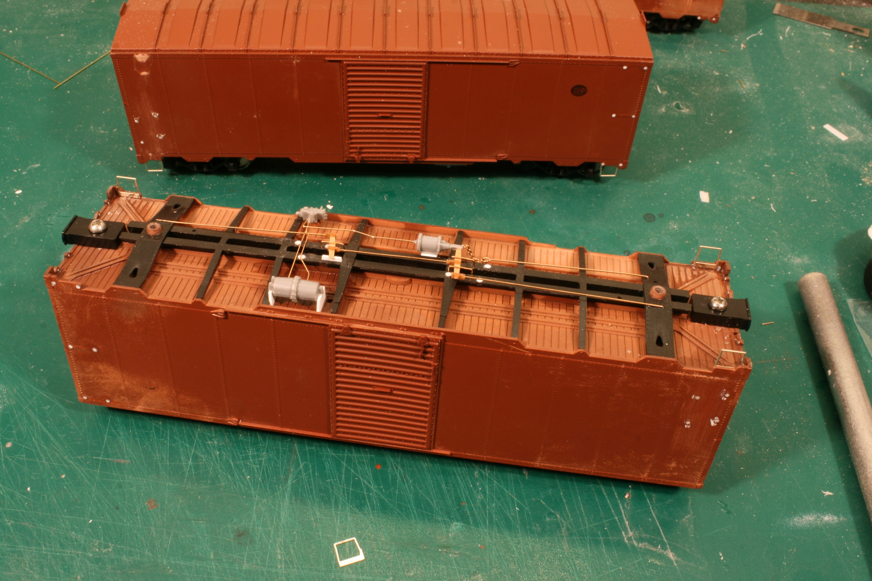

Slide 16
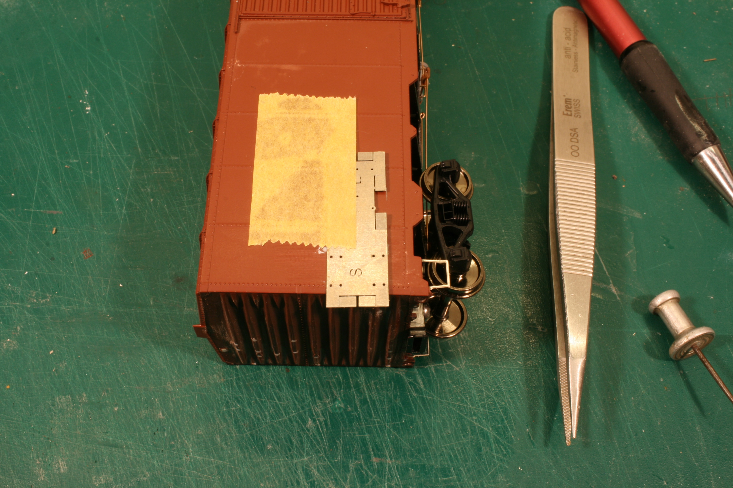

Slide 17
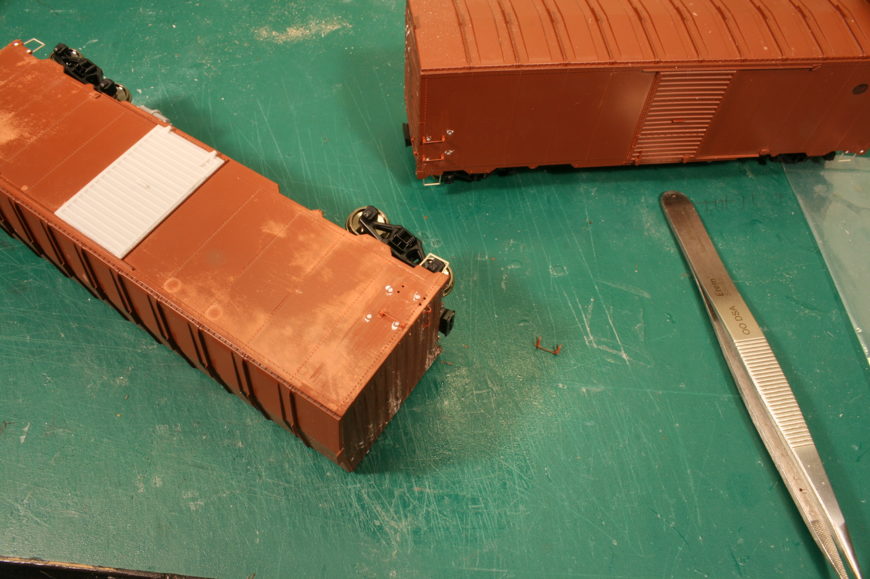

Slide 18
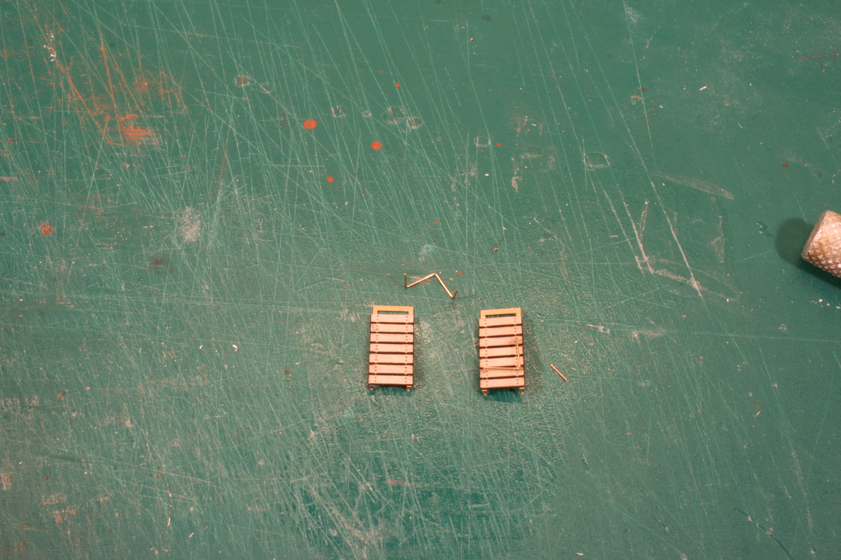

Slide 19
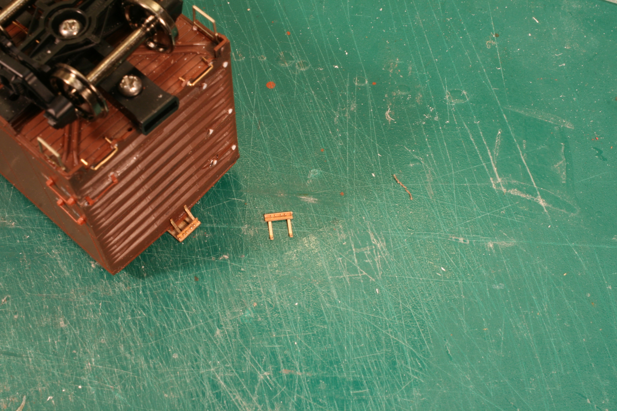

Slide 20
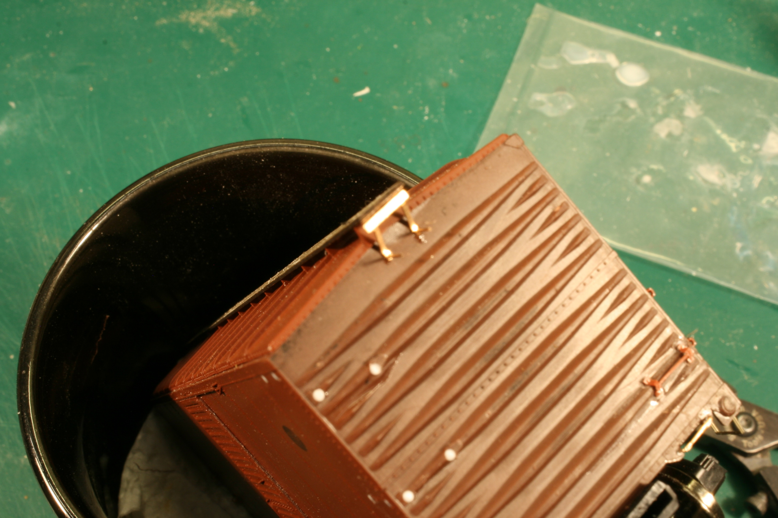

Slide 21
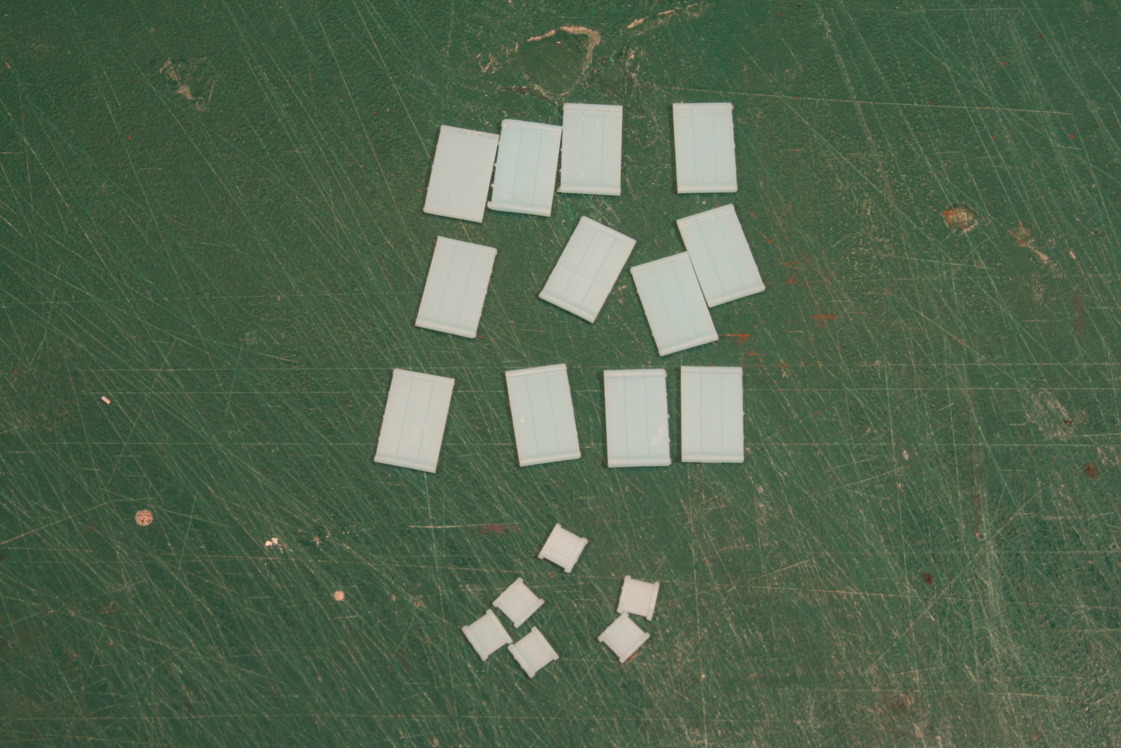

Slide 22
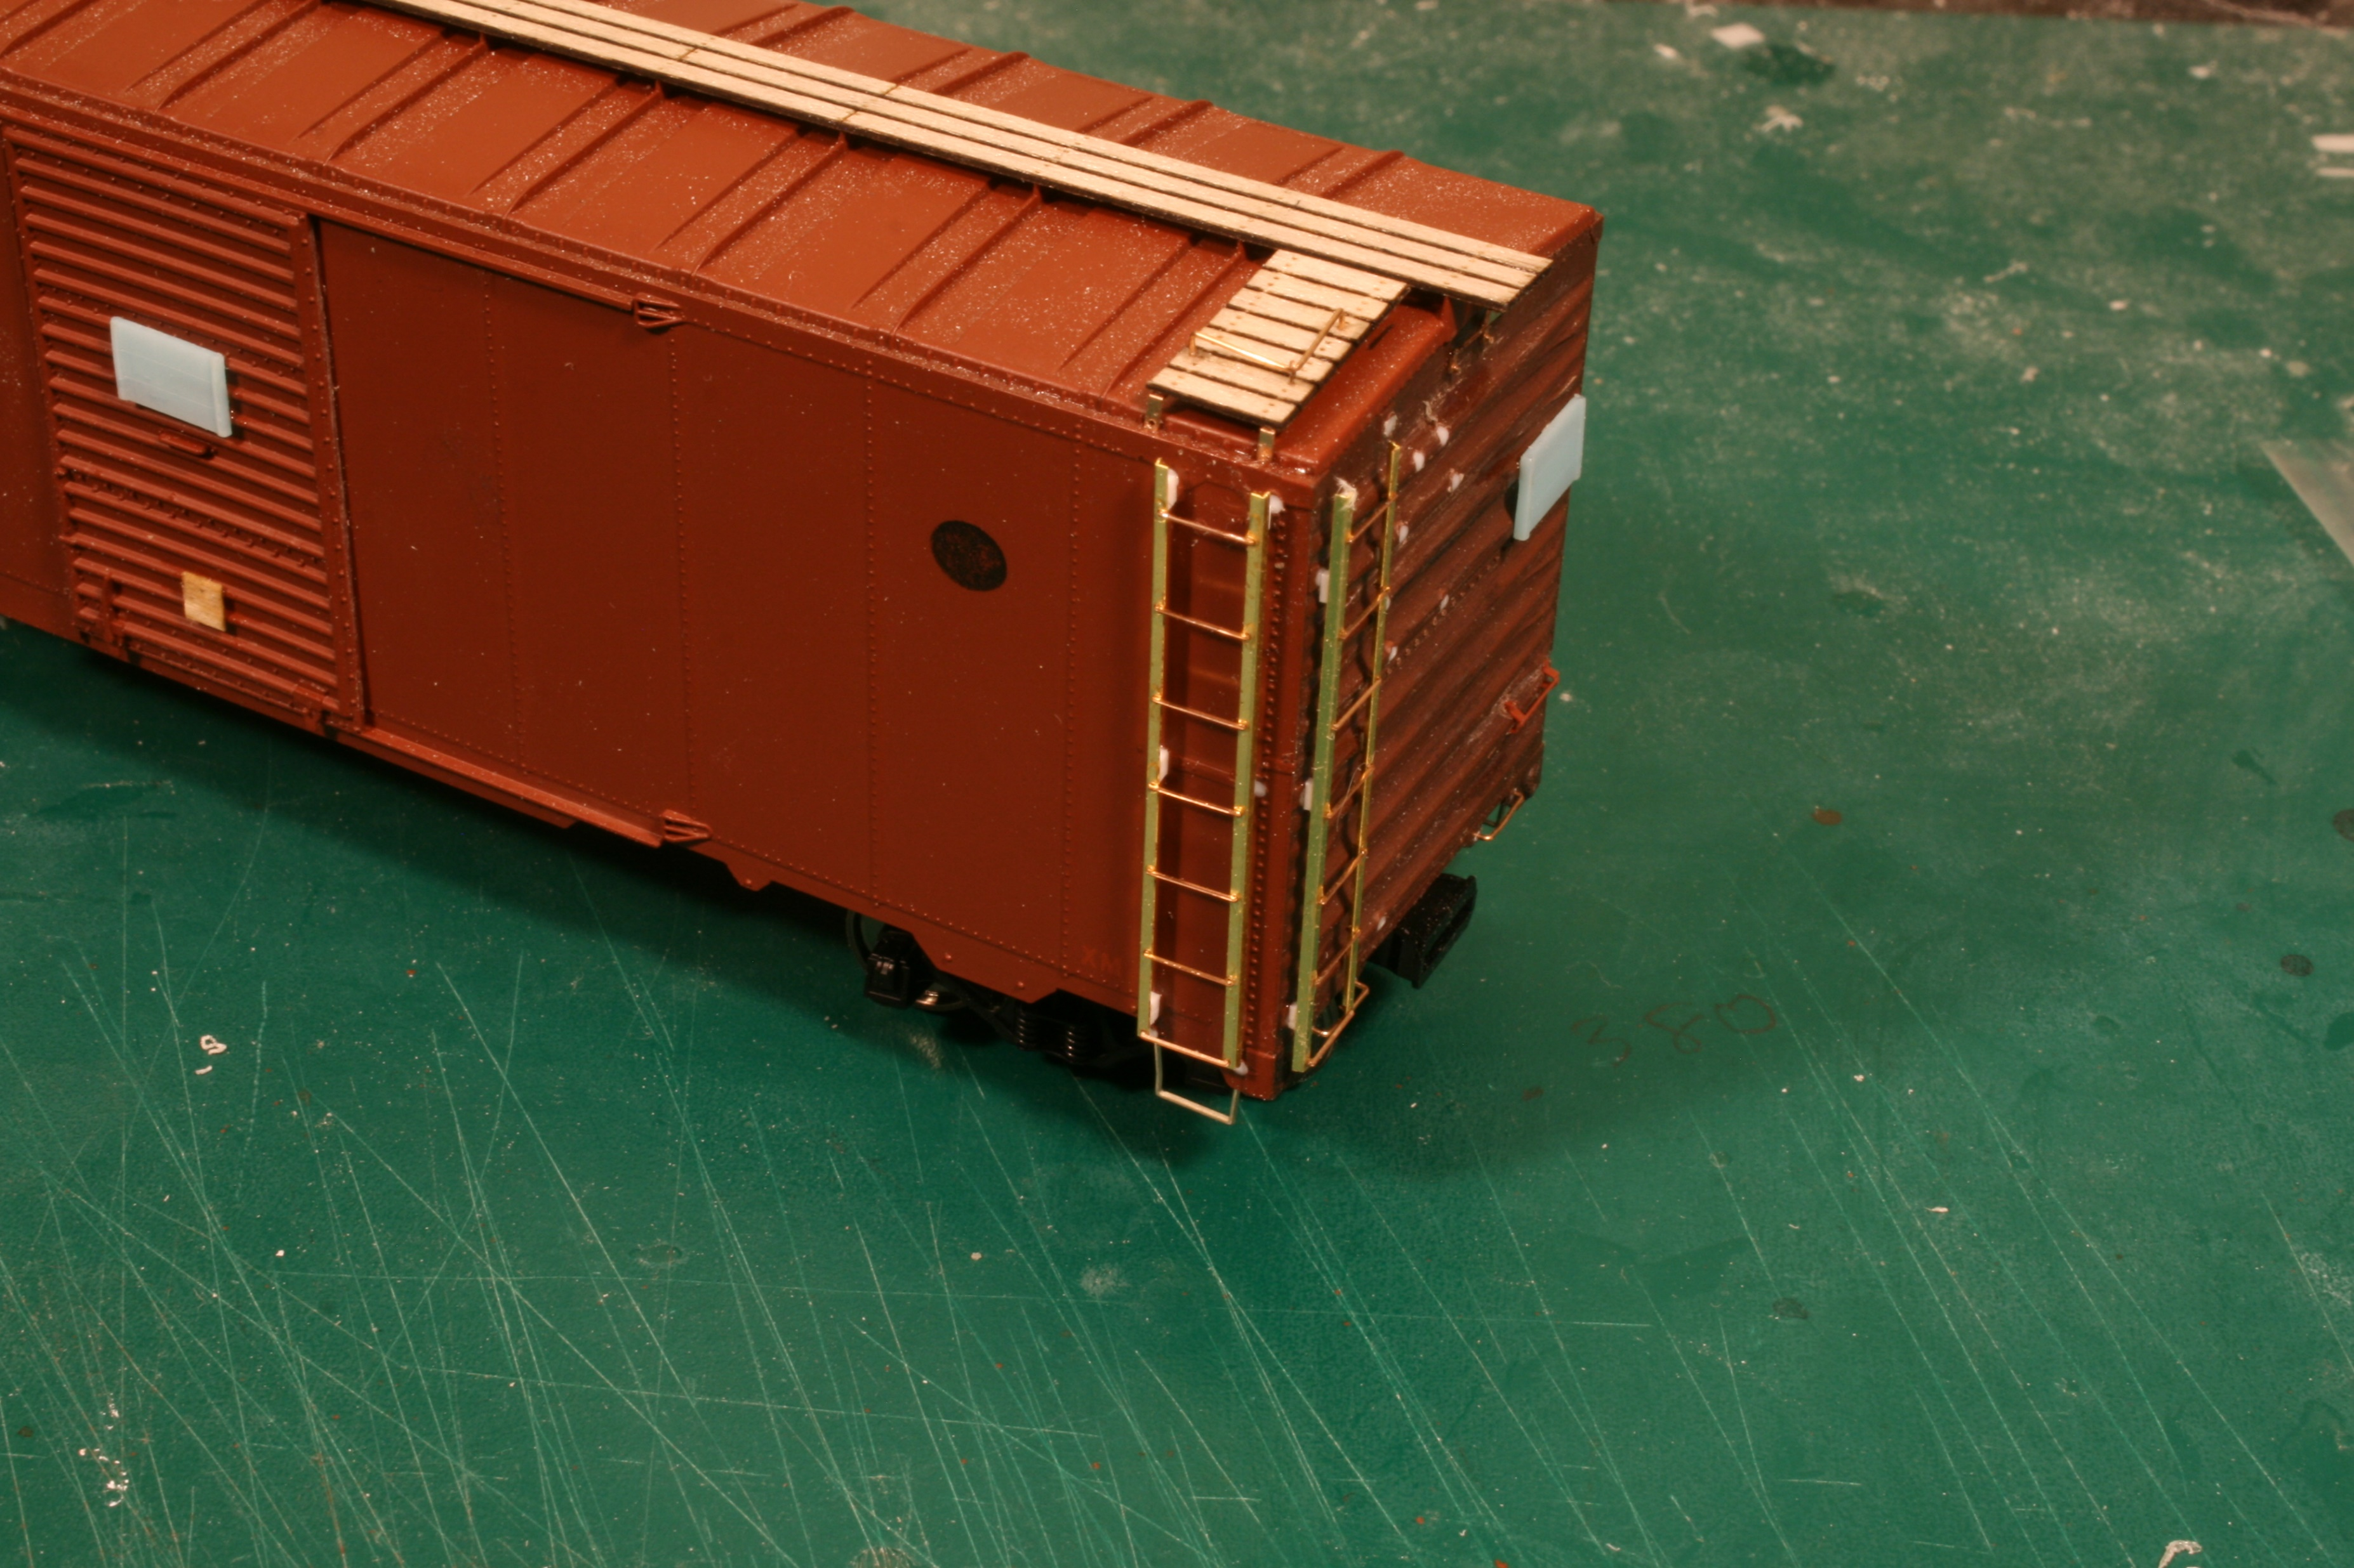

Slide 23
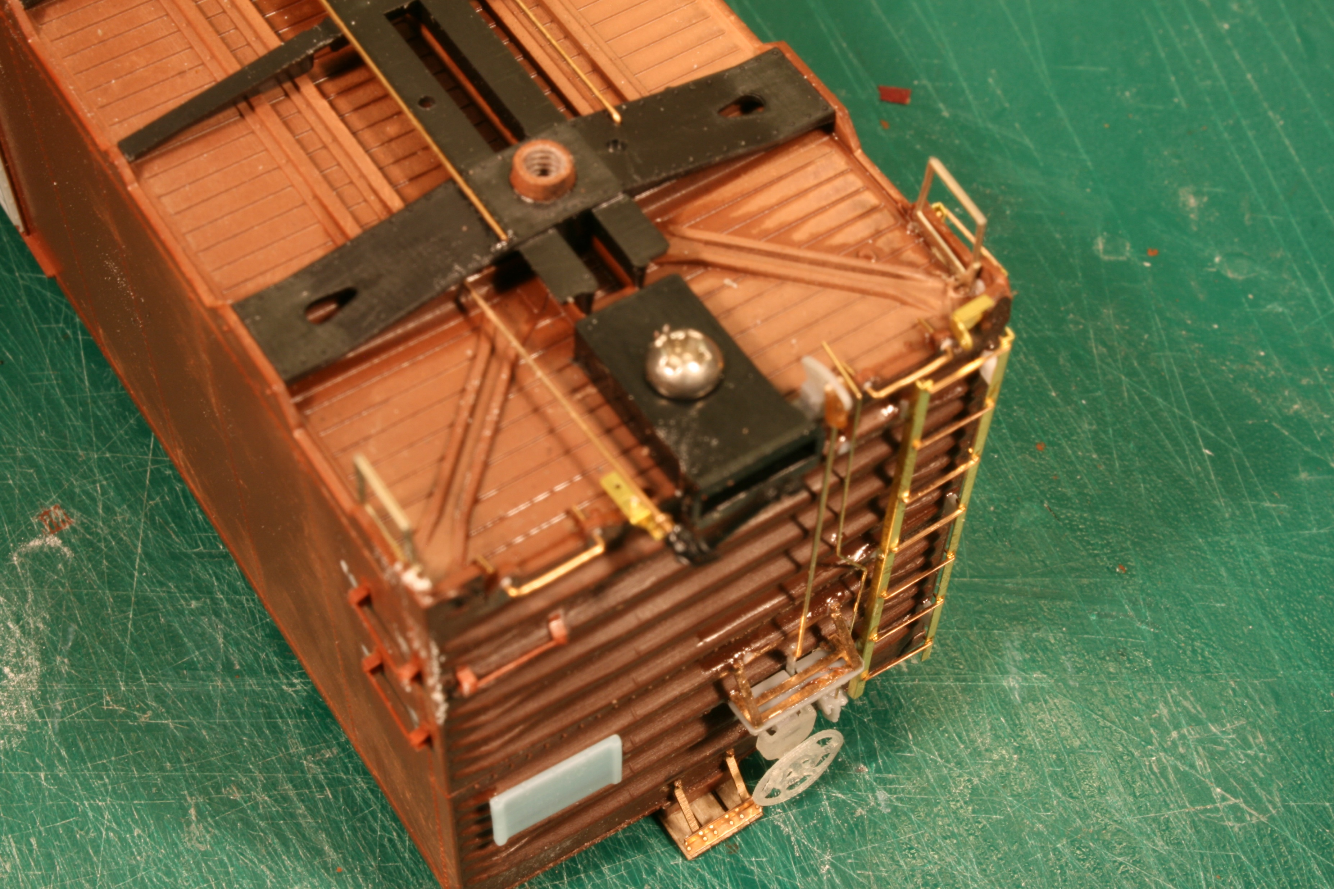

Slide 24
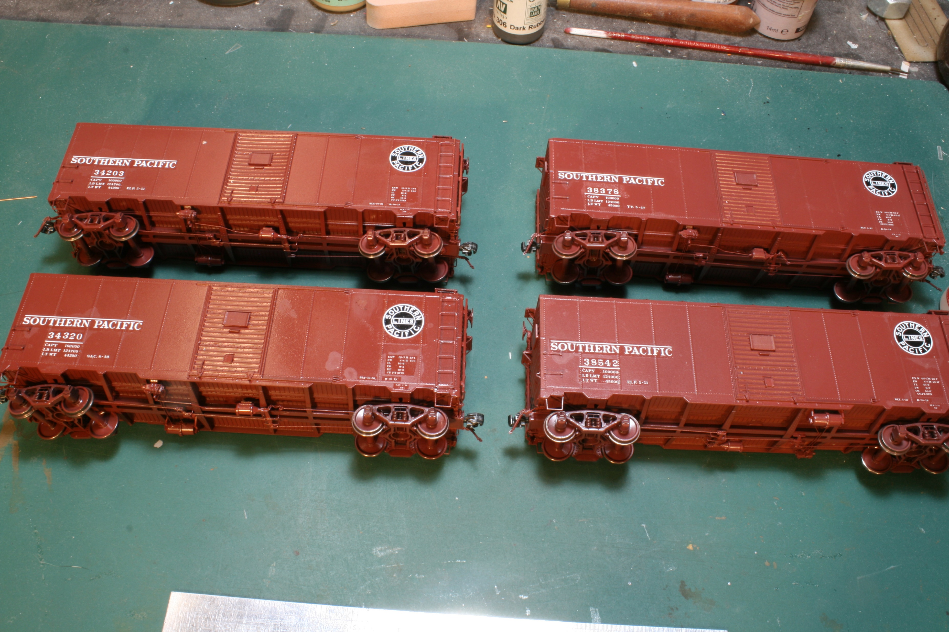

Slide 25
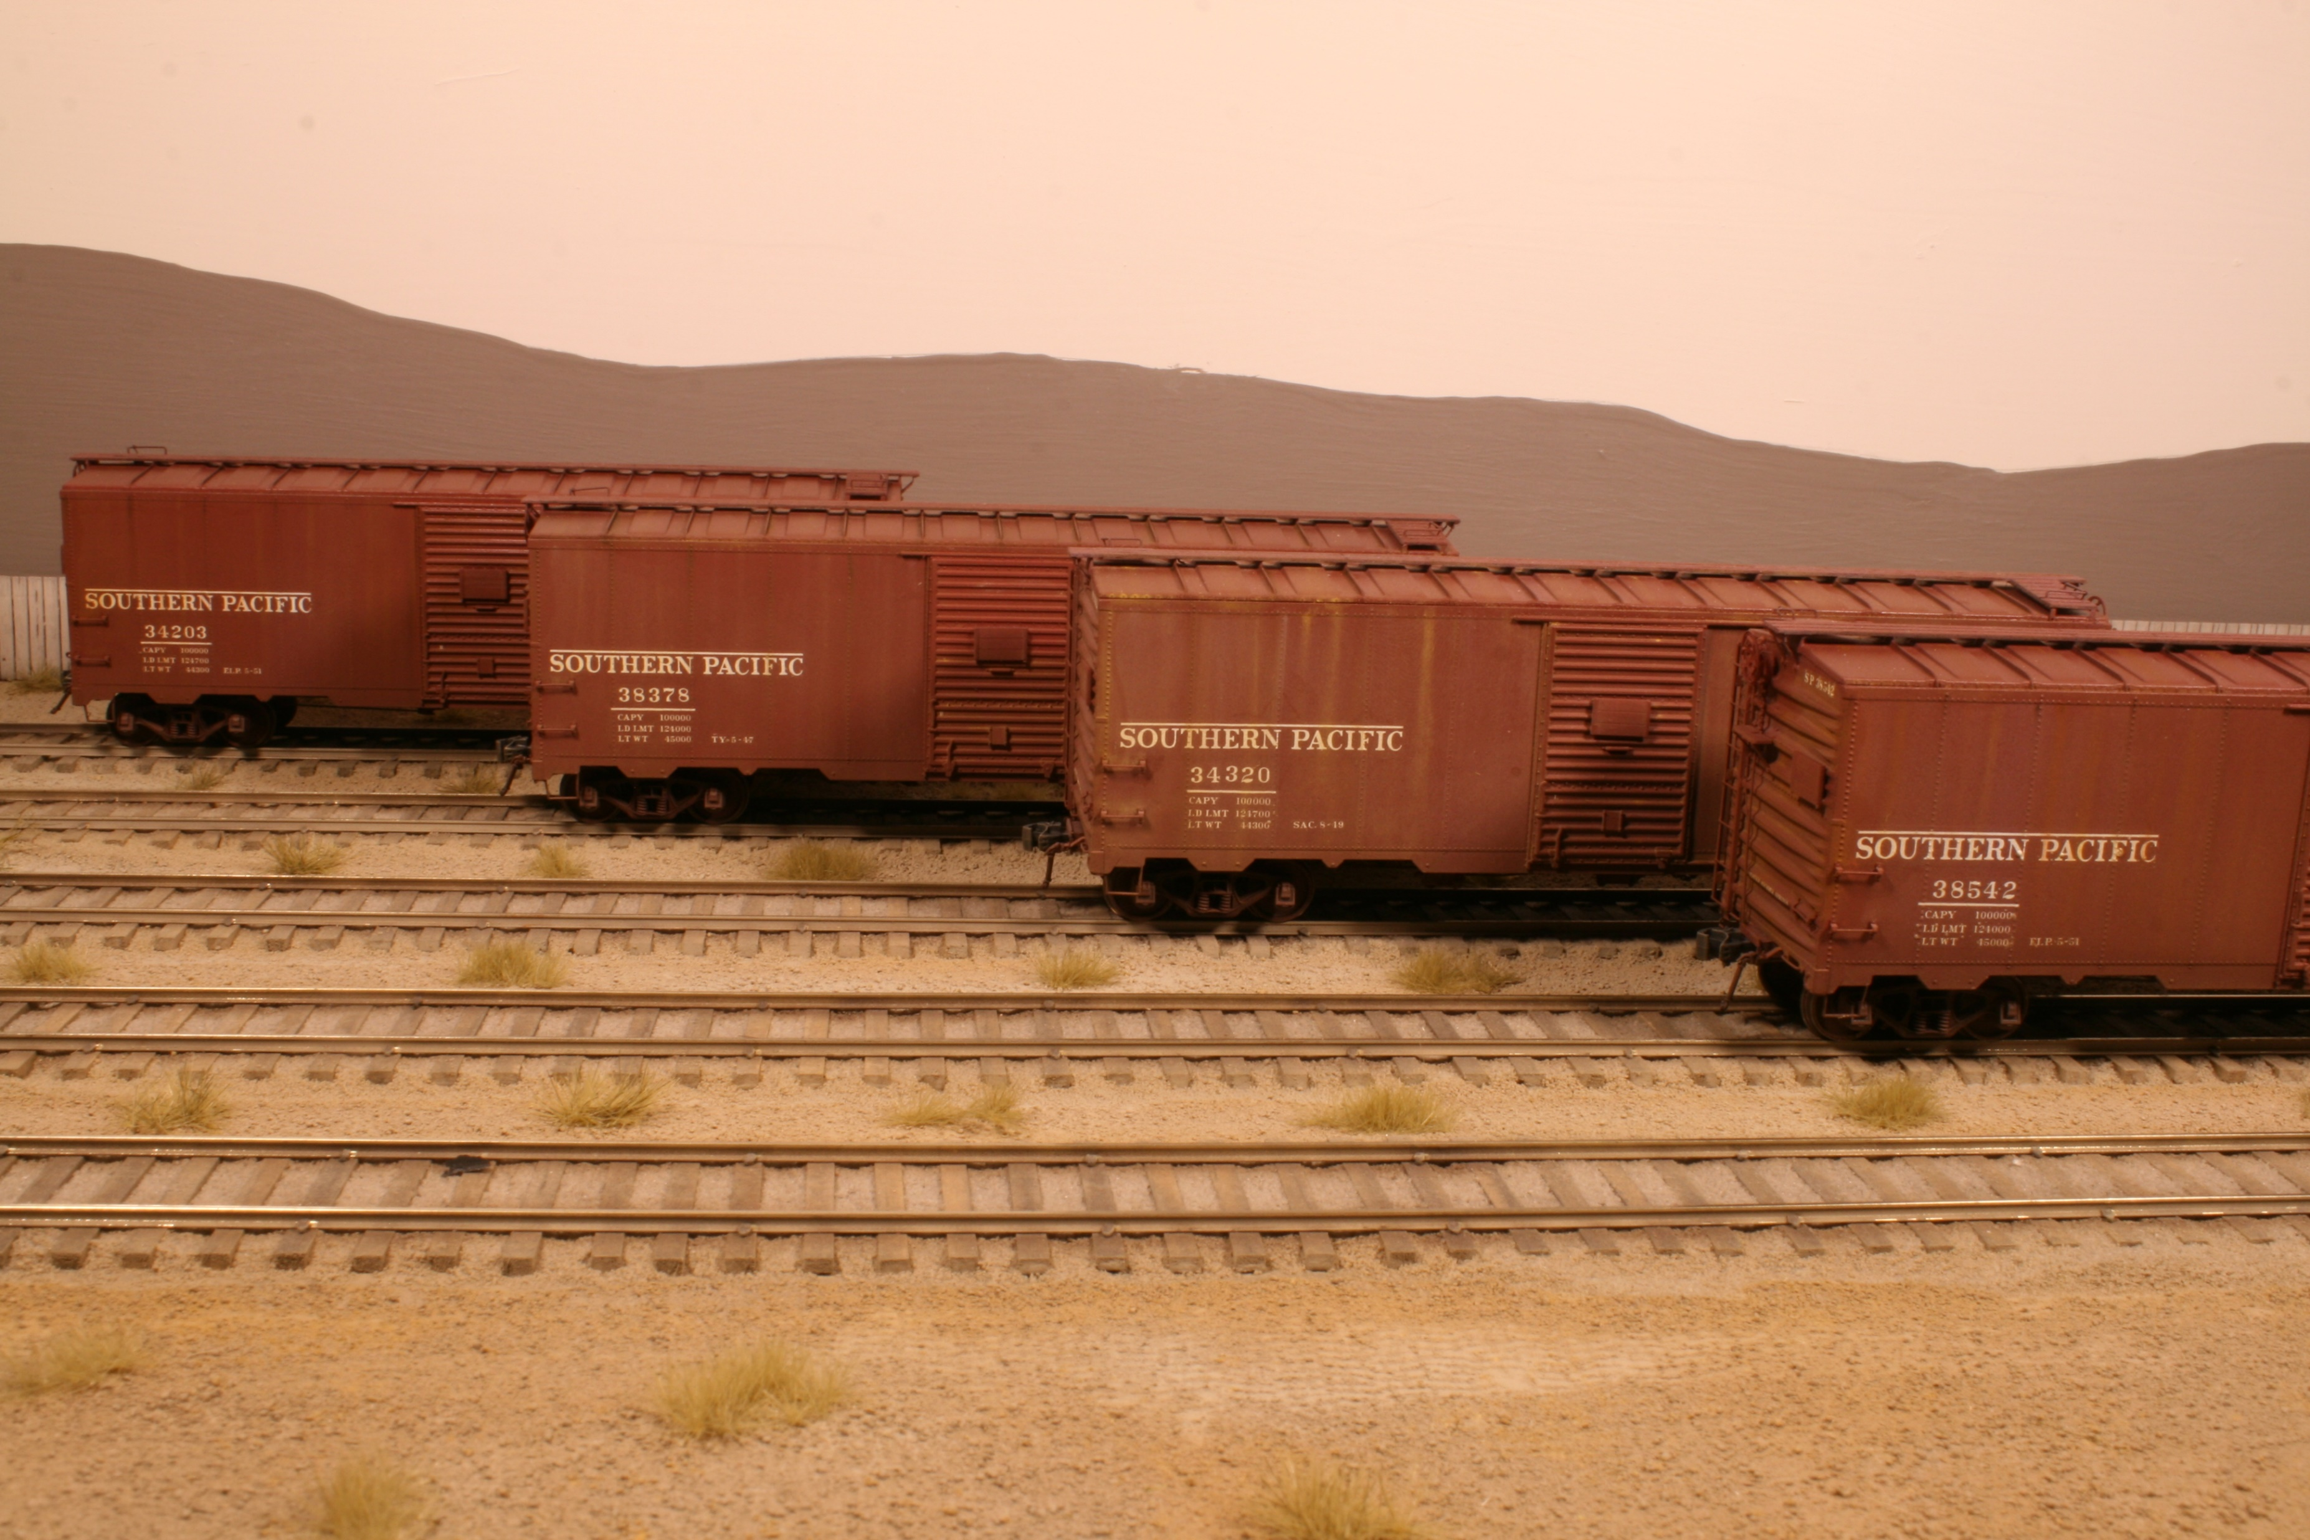

Slide 26
Upgrading IMWX boxcar kits Parts list Kadee #2250 Bracket grabs #438 Airhoses
Tichy Train Group #3013 AB brake set #8021 HO turnbuckles #3021 18” straight grabs #3028 Corner grabs
Yarmouth Model Works #304 18” 7R ladder stiles #353 17.5” rungs #201 Sill steps or IMWX boxcars #501 Eyebolts #502 Drilling template for Kadee bracket grabs #503 Brake levers #506 Airhose Bracket #507 Cut lever bracket #255 40’ laser cut running board and brackets #3137 Tack Boards

